Slide 1

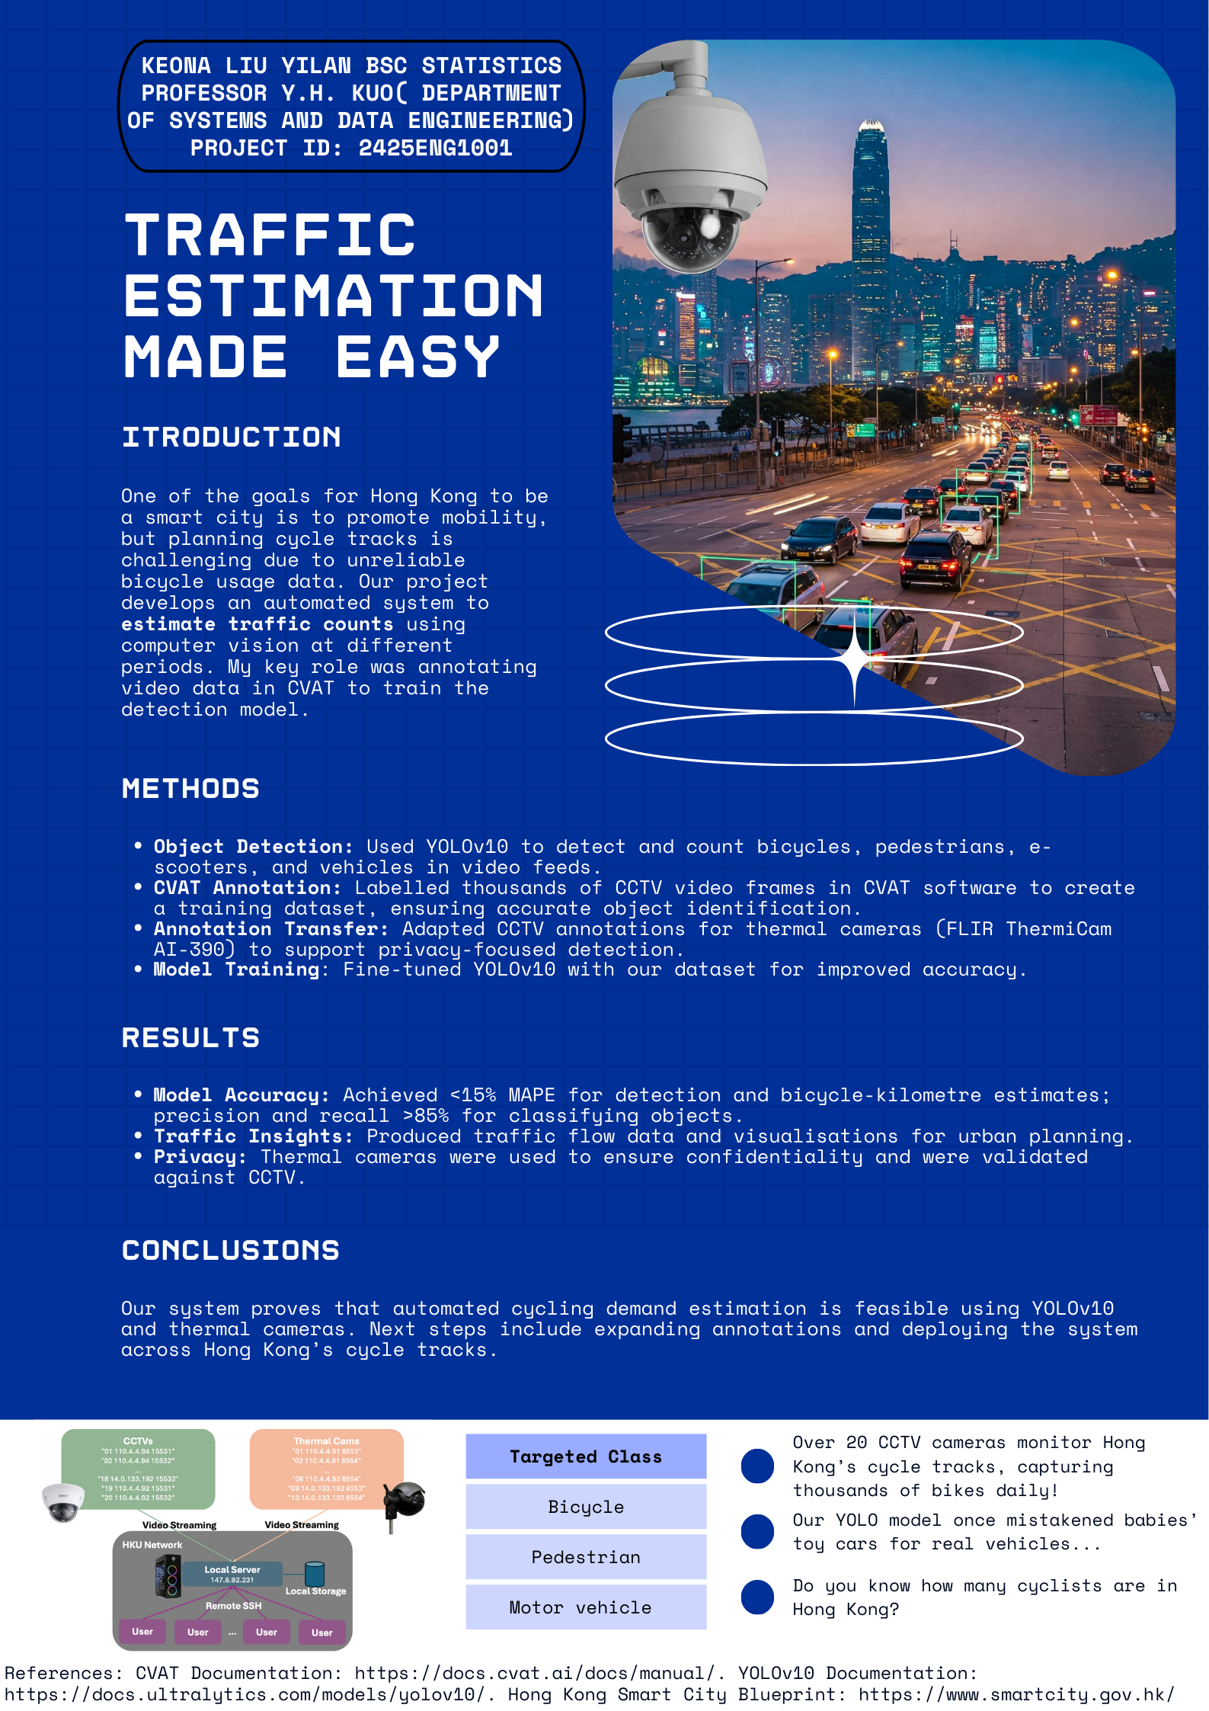
Eureka Project Title & ID
Student Name: | Keona Liu Yilan | Project Mentor: | yhkuo@hku.hk
Major: | Statistics | Department: | Data and systems engineering

