Slide 1

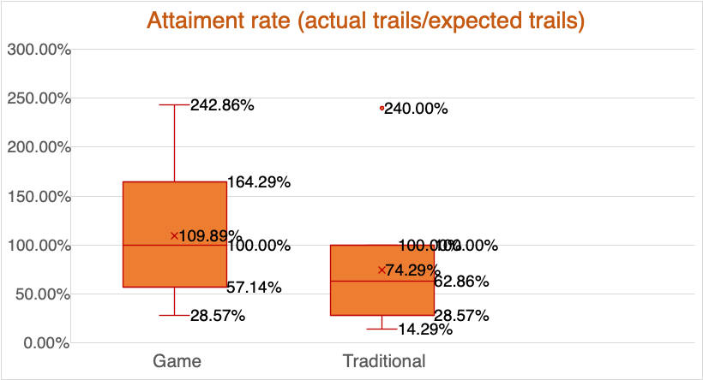
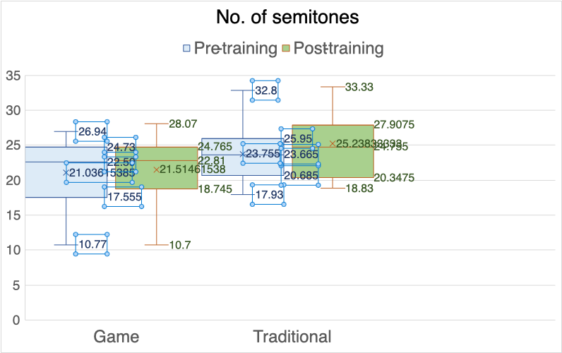
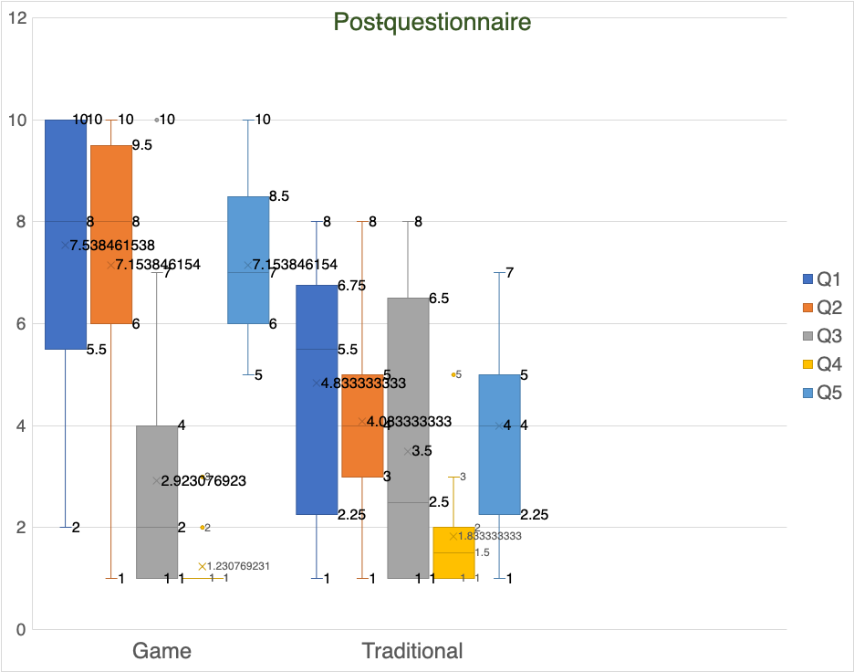
Effectiveness of game-based oromotor exercises on laryngeal elevation in healthy adults 2425EDU1001 | Effectiveness of game-based oromotor exercises on laryngeal elevation in healthy adults 2425EDU1001 | Effectiveness of game-based oromotor exercises on laryngeal elevation in healthy adults 2425EDU1001 | Effectiveness of game-based oromotor exercises on laryngeal elevation in healthy adults 2425EDU1001
Student Name: | SHI TSANG MAN | Project Mentor: | Professor CHAN Man Kei Karen
Major: | Econ&Fin | Department: | Faculty of Education
INTRODUCTION
Laryngeal elevation is essential for safe swallowing, yet traditional oromotor exercises (OMEs) face a critical challenge: low adherence due to monotonous routines. This study evaluates whether game-based OMEs can outperform traditional methods in adherence and functional outcomes.
Objectives:
  Investigate the effectiveness of game-based oromotor exercises (OME) in improving laryngeal elevation functions in adults.
  Compare adherence rates between game-based OME and traditional OME during home practice.
Hypothesis:While short-term practice may not yield significant improvements in laryngeal elevation, participants using game-based OME are anticipated to demonstrate higher adherence to home exercises compared to those using traditional methods.
METHODOLOGY
Participants:Randomized into two groups: game-based OME (via iPad app) or traditional OME (non-gamified).
Procedure: 1.Baseline Assessment: All participants performed pitch glide tasks (5× ascending and 5× descending glides). Audio recordings captured maximum/minimum pitch (pre-training) for semitone analysis.
2.Intervention:Game-based Group: Completed 15-minute daily exercises via a research app (adherence tracked via in-app logs). Traditional Group: Performed 15-minute daily exercises without gamification (adherence tracked via self-submitted audio/video recordings).3.Post-Training Evaluation:Repeated pitch glide tasks (post-training) and questionnaire assessing motivation, effort, discomfort, and enjoyment (1–10 Likert scale).
Data Analysis: 1. Adherence: Attainment rate = (Actual trials / Expected trials) × 100% (Expected trials = 175/week).
2. Laryngeal Function: Semitone range calculated as 12 × log₂(f₂ / f₁),where f1= average maximum pitch, f2 = average minimum pitch.
RESULTS
1.Adherence (Attainment Rate):
  Game-based Group:Median = 100%, Average = 109.89% (range: 28.57–242.86%).
  Traditional Group:Median = 57.14%, Average = 71.95% (range: 14.29–100%).
Key Insight: Game-based participants exceeded expected trials, while traditional participants underperformed (p < 0.05).
3. Questionnaire Feedback:
  Game-based Group reported higher motivation (Q1: Avg = 7.5/10), willingness to continue (Q2: 7.2/10), and enjoyment (Q5: 7.2/10) vs. traditional grou (Q1: 4.8/10; Q2: 4.1/10; Q5: 4.0/10).
  Both groups reported minimal physical discomfort (Q4: ≤1.5/10).
2. Laryngeal Elevation (Semitone Range):
  Game-based Group:Pre-training: Avg = 21.04 semitones; Post-training: Avg = 18.75 semitones.
  Traditional Group:Pre-training: Avg = 23.76 semitones; Post-training: Avg = 25.24 semitones.
Key Insight: No significant improvement in either group, aligning with the hypothesis that short-term practice limits physiological gains.
CONCLUSION
Game-based OME achieved significantly higher adherence (median=100%) vs. traditional OME (57.14%), supporting the hypothesis. While no short-term laryngeal improvement occurred, gamification enhanced motivation and enjoyment (Q1/Q5: ~7.5/10 vs. ~4/10 in traditional group). Results underscore gamification’s potential to overcome adherence barriers in home-based rehabilitation. Future studies should explore long-term functional outcomes and clinical applications.
References
Zhang J, Zhou Y, Wei N, Yang B, Wang A, et al. (2016) Laryngeal Elevation Velocity and Aspiration in Acute Ischemic Stroke Patients. PLOS ONE 11(9): e0162257.G

