Slide 1

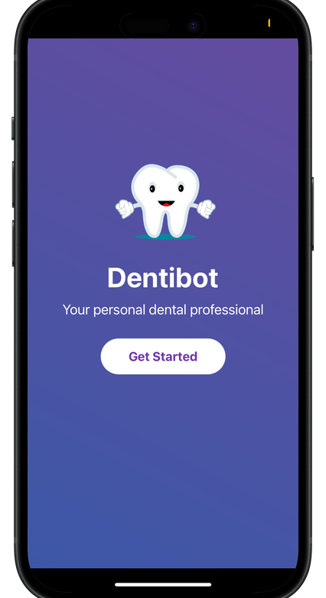
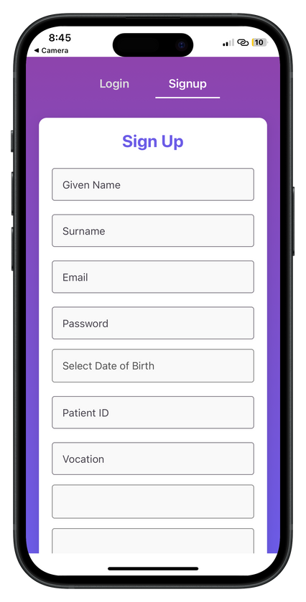

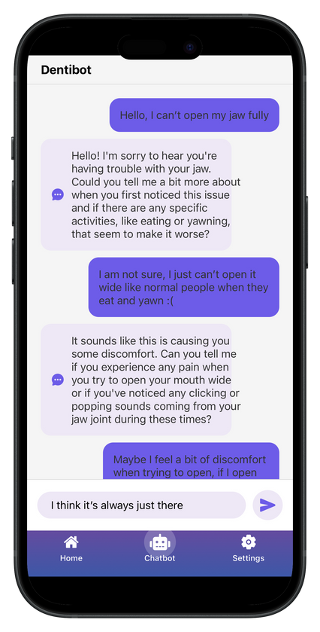

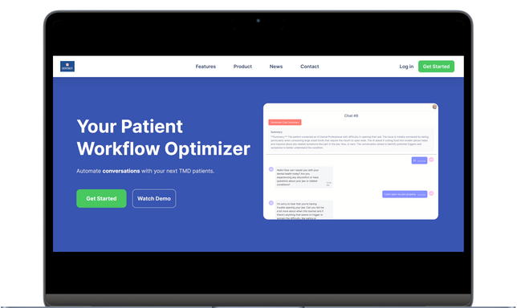
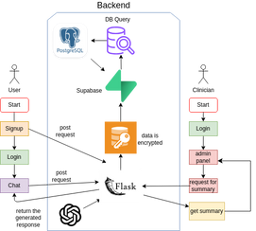
EUREKA - Undergraduate Research Programme
Head of Research
Professor Yang Teddy Weifa [Faculty of Dentistry], Professor Yu Lequan [Faculty of Science]
Member
Chowdhury Aosaf Ershad [BEng(CompSc)], Kwong Yui Yin [BEng(CompSc)], Chan Ka Ho [BDS]
Development of a Large Language Model-Driven Consultation Chatbot for Temporomandibular Joint Disorders (2425DEN1002)
Introduction
Objective
Temporomandibular disorders (TMDs) are a group of conditions affecting the jaw joint and surrounding muscles, often causing pain, discomfort, and restricted movement.
This research aimed to develop a system powered by LLMs to automate the patient interview process for TMDs. Given the unspecialized knowledge base of existing LLMs, it aimed to integrate a Retrieval-Augmented Generation (RAG)-enhanced Large Language Model (LLM) with patient-specific medical data that would streamline the patient data collection. Furthermore, the project aimed to further provide clinicians with a system to generate structured summaries of the conversations to accelerate clinical decision-making. The proposed approach attempted to enhance both the workflow and the overall quality of care in managing TMDs.​
The diagnosis of these conditions continues to remain time-intensive, requiring long dentist-led interviews and patient self-reports.
Further imprecision in collating relevant patient histories into diagnostic context means that traditional methods vary in care methodologies.
This project is aimed to address these issues.
Methodology
The software development process was initiated with dialogues between the interdisciplinary team to underscore the problem statement and the required logic. A principal architectural logic and technical stack was decided, keeping in mind the time constraints and the technical capacity of the team. The project was initiated with the setting of the development environment and relevant assignment of tasks (in order of priority).
To support the development of a context-aware chatbot with efficient communication with the frontend. Concurrently, the dental research team was involved in reviewing technical literature to identify key questions and topics relevant to TMD. The information obtained was chunked through the use of LangChain and was eventually supplied to OpenAI’s text-embedding-3-small model to create vector embeddings, which were stored in a Chroma database.
A Retrieval-Augmented Generation (RAG) model was created using a relevant prompt containing the conversation scenario, conversation context, and the retrieved relevant chunks of information, which were provided to LLMs. This allowed LLMs to provide context-specific responses with great diagnostic alignment. Multiple LLMs were tested, with some successfully hosted on local servers, eliminating the reliance on third-party APIs and improving overall security and privacy.
Dentist Dashboard
A dedicated dentist-facing web platform was also further implemented using React to allow clinicians to access the full transcript of the patient-AI conversation after completion. The portal, which is supported by the same Flask server and Supabase service, includes a feature to dynamically generate summaries of the interaction, highlighting critical symptoms, patient history, and potential risk factors.
Results
Conclusion
References
The final chatbot was able to demonstrate robust performance, successfully generating contextually relevant responses to patient-specific questions in approximately 5 seconds, achieving strong diagnostic alignment with TMD diagnostic criteria. Additionally, the leverage of the dentist portal reduced overall diagnostic prep time, with the system emphasizing the value of raw transcript access for auditing AI decisions.
This project successfully developed an LLM-driven chatbot application and a dentist portal for streamlining the TMD interview process. By integrating an RAG framework, the chatbot demonstrated strong alignment with diagnostic guidelines. While the system excelled in structured symptom identification, challenges persisted in interpreting subjective patient descriptors (e.g., pain location), underscoring the irreplaceable role of clinician judgment. Overall, this project highlights the potential of AI to augment—not replace—clinical workflows, offering a scalable solution to reduce diagnostic delays for TMD patients. By combining technical innovation with clinician feedback, the system sets a precedent for privacy-conscious, human-AI collaboration in healthcare.
Tucker, M. R., & Hupp, J. R. (2013). Medicolegal Considerations. Contemporary Oral and Maxillofacial Surgery-E-Book: Contemporary Oral and Maxillofacial Surgery-E-Book, 188.
van der Meer, H. A., Van der Wal, A. C., van Hinte, G., & Speksnijder, C. M. (2024). Counselling for patients with a temporomandibular disorder: A scoping review and concept analysis. Journal of Oral Rehabilitation, 51(11), 2484-2497.
Reid, K. I., & Greene, C. S. (2013). Diagnosis and treatment of temporomandibular disorders: an ethical analysis of current practices. Journal of Oral Rehabilitation, 40(7), 546-561.
Pow, E. H., Leung, K., & McMillan, A. S. (2001). Prevalence of symptoms associated with temporomandibular disorders in Hong Kong Chinese. Journal of orofacial pain, 15(3).
Manfredini, D., Lombardo, L., & Siciliani, G. (2017). Temporomandibular disorders and dental occlusion. A systematic review of association studies: end of an era?. Journal of oral rehabilitation, 44(11), 908-923.
Manfredini, D. (2011). The triangle bruxism, pain, and psychosocial factors [PhD Thesis]. Academic Centre for Dentistry Amsterdam (ACTA), Amsterdam, The Netherlands.

